Slide 1
Data Compression for comet interceptor
Project overview, Huffman coding, golomb coding, initial difference and difference recursion, further work?

Slide 2
Project Overview
Magnetometer data will be provided as 14 bit signed integers
Create algorithms to achieve the highest possible compression ratio
Compression technique must be lossless
Optimise highest compression ratio versus lowest latency
Account for low processing capability due to hardware limitations

Slide 3
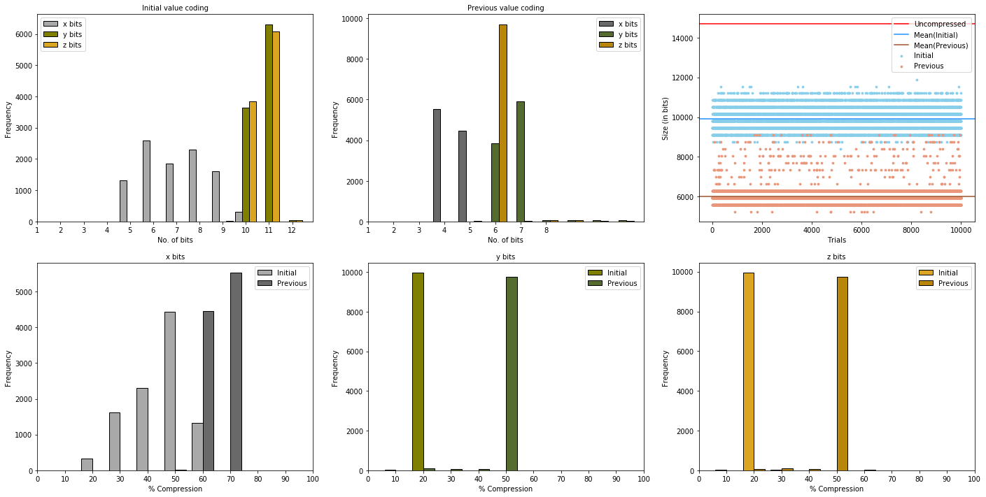
Difference ENCoding

Slide 4

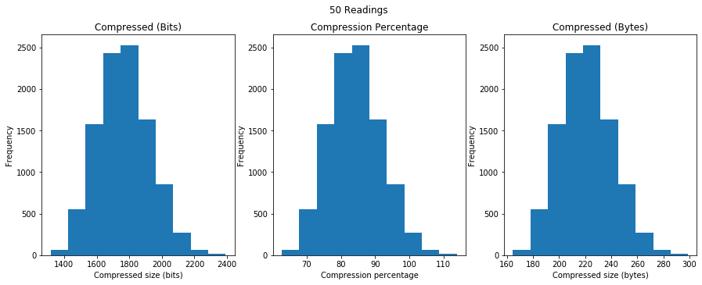
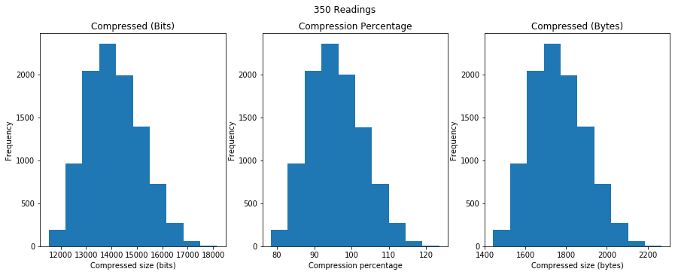
Huffman enCoding
Compression ratio centred around 85% for 50 readings and 95% for 350 readings
Despite its widespread usage, Huffman cannot be used for our set of time series data

Slide 5
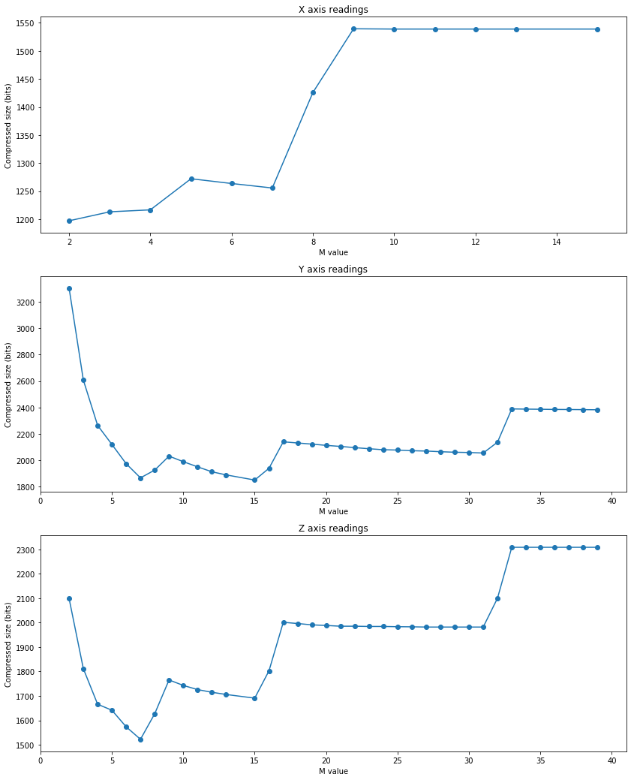
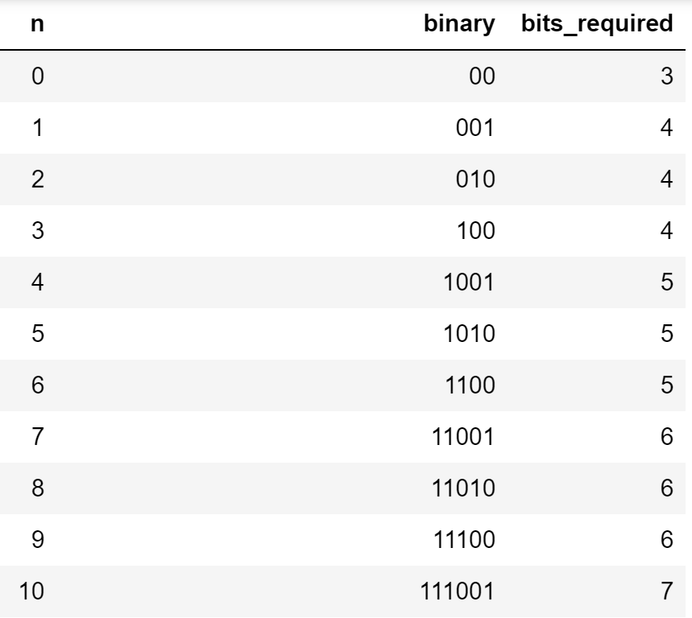
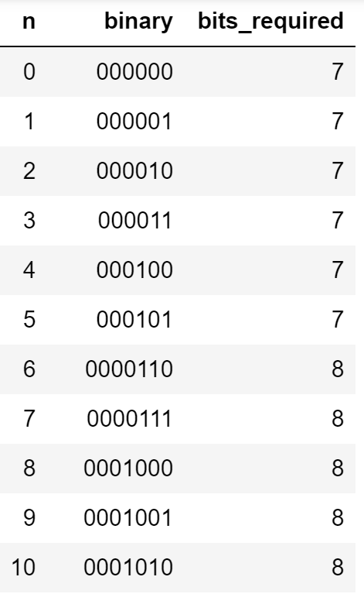
Golomb encoding
Optimal M value inconsistent across axes
Provides compression ratio of 31%

Slide 6
Review and further work
Golomb coding with difference recursion provides the best compression ratio of 31%
Is there a perfect sample size for lowest latency and best compression ratio?
Can we dynamically allocate an M value for Golomb coding?
How can we change sample size dynamically to account for periods of inactivity?

Slide 7
Thank you for your attention
Any Questions?
Simplify slides, less graphs, explain algorithms with diagrams not words

